Slide 1
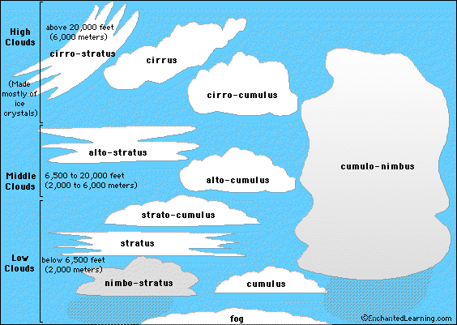
CLOUDS

Slide 2
Definition
“A large-scale distributed computing paradigm that is driven by economies of scale, in which a pool of abstracted, virtualized, dynamically-scalable, managed computing power, storage, platforms, and services are delivered on demand to external customers over the Internet.”
(According to Foster, Zhao, Raicu and Lu, Cloud Computing and Grid Computing 360-Degree Compared, 2008)
Grid Computing, MIERSI, DCC/FCUP

Slide 3
Cloud Computing
Just a new name for Grid?
Grid Computing, MIERSI, DCC/FCUP

Slide 4
Cloud Computing
Just a new name for Grid?
Yes…
Grid Computing, MIERSI, DCC/FCUP

Slide 5
Cloud Computing
Just a new name for Grid?
…No….
Grid Computing, MIERSI, DCC/FCUP

Slide 6
Cloud Computing
Just a new name for Grid?
Nevertheless Yes!!!
Grid Computing, MIERSI, DCC/FCUP

Slide 7
Cloud: just a new name for Grid?
YES:
  Reduce the cost of computing
  Increase reliability
  Increase flexibility (third party)
Grid Computing, MIERSI, DCC/FCUP

Slide 8
Cloud: just a new name for Grid?
NO:
  Great increase demand for computing (clusters, high speed networks)
  Billions of dollars being spent by Amazon, Google, Microsoft to create real commercial large-scale systems with hundreds of thousands of computers – www.top500.org shows computers with 100,000+ cores
  Analysis of massive data
Grid Computing, MIERSI, DCC/FCUP

Slide 9
Cloud: just a new name for Grid?
Nevertheless YES:
  Problems are the same in clouds and grids
  Common need to manage large facilities
  Define methods to discover, request and use resources
  Implement highly parallel computations
Grid Computing, MIERSI, DCC/FCUP

Slide 10
Clouds: key points of the definition
Differences related to traditional distributed paradigms:
  Massively scalable
  Can be encapsulated as an abstract entity that delivers different levels of service
  Driven by economies of scale
  Services can be dynamically configured (via virtualization or other approaches) and delivered on demand
Grid Computing, MIERSI, DCC/FCUP

Slide 11
Clouds: reasons for interest
Rapid decrease in hw cost, increase in computing power and storage capacity (multi-cores etc)
Exponentially growing data size
Widespread adoption of Services Computing and Web 2.0 apps
Grid Computing, MIERSI, DCC/FCUP

Slide 12
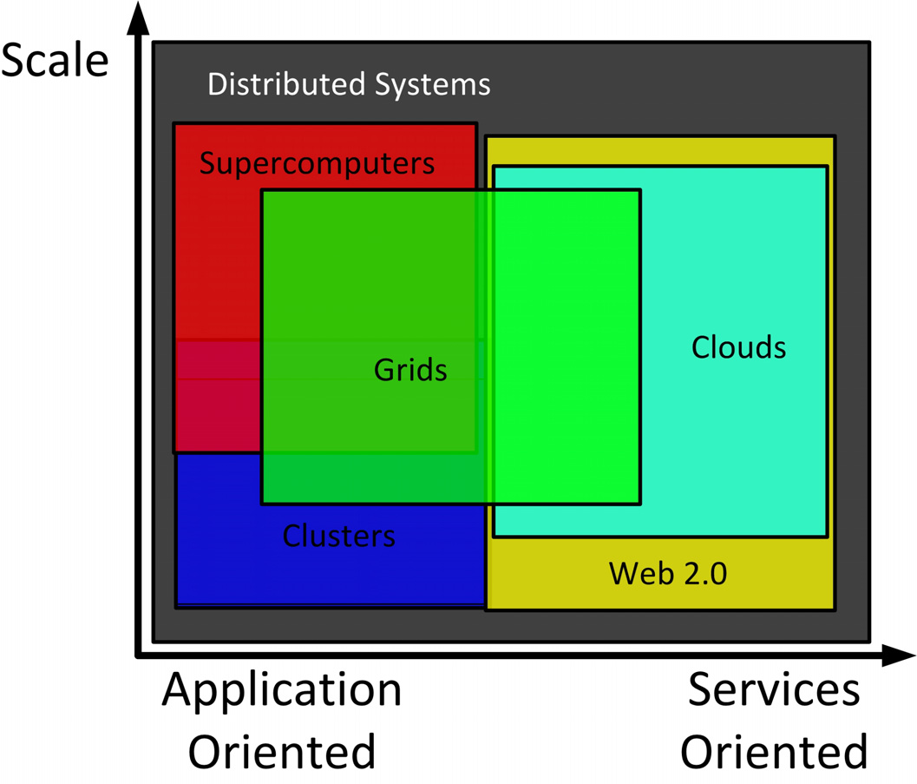
Clouds: relation with other paradigms
Grid Computing, MIERSI, DCC/FCUP

Slide 13
Clouds: yet about definition…
“The interesting thing about Cloud Computing is that we’ve redefined Cloud Computing to include everything that we already do. . . . I don’t understand what we would do differently in the light of Cloud Computing other than change the wording of some of our ads.”
Larry Ellison (Oracle CEO), quoted in the Wall Street Journal, September 26, 2008
Grid Computing, MIERSI, DCC/FCUP

Slide 14
Clouds: yet about definition…
“A lot of people are jumping on the [cloud] bandwagon, but I have not heard two people say the same thing about it. There are multiple definitions out there of “the cloud.””
Andy Isherwood (HP VP of sales), quoted in ZDnet News, December 11, 2008
Grid Computing, MIERSI, DCC/FCUP

Slide 15
Clouds: yet about definition…
“It’s stupidity. It’s worse than stupidity: it’s a marketing hype campaign. Somebody is saying this is inevitable — and whenever you hear somebody saying that, it’s very likely to be a set of businesses campaigning to make it true.”
Richard Stallman (known for his advocacy of free software), quoted in The Guardian, September 29, 2008
Grid Computing, MIERSI, DCC/FCUP

Slide 16
Clouds: yet about definition…
From a hardware point of view, three aspects are new in Cloud Computing:
  The illusion of infinite computing resources available on demand, thereby eliminating the need for Cloud Computing users to plan far ahead for provisioning;
  The elimination of an up-front commitment by Cloud users, thereby allowing companies to start small and increase hardware resources only when there is an increase in their needs; and
  The ability to pay for use of computing resources on a short-term basis as needed (e.g., processors by the hour and storage by the day) and release them as needed, thereby rewarding conservation by letting machines and storage go when they are no longer useful.
Grid Computing, MIERSI, DCC/FCUP

Slide 17
Clouds: side-by-side comparison with grids
Business model
Architecture
Resource Management
Programming model
Application model
Security model
Grid Computing, MIERSI, DCC/FCUP

Slide 18
Clouds: side-by-side comparison with grids
Business model
  Traditional: one-time payment for unlimited use of software
  Clouds: pay the provider on a comsumption basis, computing and storage (like electricity, gas etc)
  Grids: project-oriented, trading, negotiation, provisioning, and allocation of resources based on the level of services provided
Grid Computing, MIERSI, DCC/FCUP

Slide 19
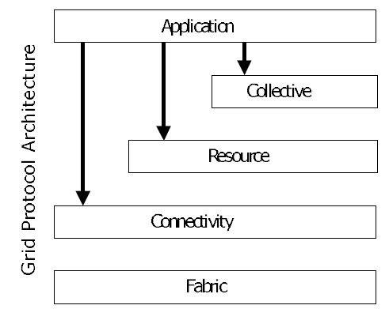
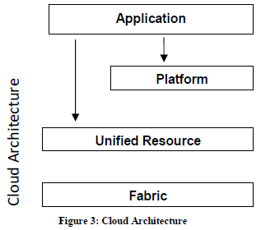
Clouds: side-by-side comparison with grids
Architecture
Grid Protocol Architecture
Grid Computing, MIERSI, DCC/FCUP

Slide 20
Clouds: side-by-side comparison with grids
Fabric Layer: same as grid fabric layer (resources)
Unified Resource Layer: resources that have been abstracted/encapsulated (usually by virtualization) – virtual computer or cluster, logical file system,, database etc.
Platform Layer: web hosting environment, scheduling service etc.
Grid Computing, MIERSI, DCC/FCUP

Slide 21
Clouds: side-by-side comparison with grids
It is possible for clouds to be implemented over existing grid technologies leveraging more than a decade of community efforts on standardization, security, resource management, and virtualization support!
Grid Computing, MIERSI, DCC/FCUP

Slide 22
Clouds: services
Infrastructure as a Service (IaaS): hw, sw, equipments, can scale up and down dynamicallly (elastic). E.g.:
  Amazon Elastic Compute Cloud (EC2) and Simple Storage Service (S3)
  Eucalyptus: open source Cloud implementation compatible with EC2 (allows to set up local cloud infra prior to buying services)
Grid Computing, MIERSI, DCC/FCUP

Slide 23
Clouds: services
Platform as a Service (PaaS): offers high level integrated environment to build, test, and deploy custom apps.
  Restrictions on sw used to develop apps in exchange for built-in scalability. E.g.: Google App Engine
Grid Computing, MIERSI, DCC/FCUP

Slide 24
Clouds: services
Software as a Service (SaaS): delivers special purpose software that is remotely accessible. E.g,: Google Maps, Live Mesh from Microsoft etc
Grid Computing, MIERSI, DCC/FCUP

Slide 25
Clouds: side-by-side comparison with grids
Resource management
  Compute model
  Data model
  Virtualization
  Monitoring
  provenance
Grid Computing, MIERSI, DCC/FCUP

Slide 26
Clouds: side-by-side comparison with grids
Resource management
Compute model
  Grids: batch-scheduled (queueing systems)
  Clouds: resources shared by all users at the same time (??!) in contrast to dedicated resources in queueing systems
  Maybe one of the major challenges in clouds: QoS!
Grid Computing, MIERSI, DCC/FCUP

Slide 27
Clouds: side-by-side comparison with grids
Resource management
Multiple virtual machines can share CPUs and main memory well, but….
Network and disk I/O sharing is problematic
Grid Computing, MIERSI, DCC/FCUP

Slide 28
Clouds: side-by-side comparison with grids
Resource management
75 EC2 instances running STREAM (memory benchmark)
  Mean bw = 1355 MB/s +- 52 MB/s (~4%)
Avg disk bw (to write 1GB)
  55 MB/s +- 9MB (16%)
I/O interference needs to be solved!
  Back to the architecture of mainframes???
  Use of flash memory (faster access)?
Grid Computing, MIERSI, DCC/FCUP

Slide 29
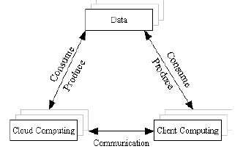
Clouds: side-by-side comparison with grids
Resource management
Data model:
  Centralized on Cloud computing?
  Future trend according to Foster, Zhao, Raicu and Lu:
Grid Computing, MIERSI, DCC/FCUP

Slide 30
Clouds: side-by-side comparison with grids
Resource management
Data model:
  Grids: concept of virtual data, replica, metadata catalog, abstract structural representation
  Data locality: to achieve good scalability data must be distributed over many computers
  Clouds: use map-reduce mechanism like in Google to maintain data locality
  Grids: rely on shared file systems (NFS, GPFS, PVFS, Lustre)
Grid Computing, MIERSI, DCC/FCUP

Slide 31
Clouds: side-by-side comparison with grids
Resource management
Combining compute and data model:
  Important to schedule computational tasks close to their data!
  Another challenge for clouds since data-intensive apps are currently not the typical apps running in cloud environments
    Currently data-intensive apps have been attracting the interest of many companies
Grid Computing, MIERSI, DCC/FCUP

Slide 32
Clouds: side-by-side comparison with grids
Resource management
Virtualization:
  Abstraction and encapsulation
  Clouds: rely heavily on virtualization
  Grids: do not rely on virtualization as much as clouds. One example of use in Grids: Nimbus (previous Virtual Workspace Service)
Grid Computing, MIERSI, DCC/FCUP

Slide 33
Clouds: side-by-side comparison with grids
Resource management
Cloud Virtualization:
  Server and app consolidation (multiple apps can run on the same server, resources can be utilized more efficiently)
  Configurability
  App availabillity (recovery)
  Improved responsiveness
  Meet SLA requirements
  AMD and Intel have been introducing hw support for virtualization → more efficiency
Grid Computing, MIERSI, DCC/FCUP

Slide 34
Clouds: side-by-side comparison with grids
Resource management
Monitoring:
  Clouds: hard to do fine-control because of virtualization (problem for users and admins). In the future maybe not a problem as clouds become self-maintained and self-healing (autonomic)
  Grids: several tools for monitoring (e.g. Ganglia)
Grid Computing, MIERSI, DCC/FCUP

Slide 35
Clouds: side-by-side comparison with grids
Resource management
Provenance:
  Grids: built into a workflow system to support discovery and reproducibility of scientific results (Chimera, Swift, Kepler, VIEW etc)
  Clouds: still unexplored
  Scalable provenance querying and secure access to provenance info are still open problems for both grids and clouds
Grid Computing, MIERSI, DCC/FCUP

Slide 36
Clouds: side-by-side comparison with grids
Programming model
  Grids: heavy use of workflow tools to be able to manage large sets of tasks and data. Focus on management rather than on interprocess communication,
  others: MPICH-G2, WSRF, GridRPC…
  Clouds: most use the map-reduce programming model. Implementation: Hadoop that uses Pig as a declarative programming language
Grid Computing, MIERSI, DCC/FCUP

Slide 37
MapReduce:
“Hello World”: Word Count
Map(String docid, String text):
  for each word w in text:
    Emit(w, 1);
Reduce(String term, Iterator<Int> values):
int sum = 0;
for each v in values:
  sum += v;
  Emit(term, value);
Grid Computing, MIERSI, DCC/FCUP

Slide 38
Clouds: side-by-side comparison with grids
Programming model
  Clouds: Microsoft uses Cosmos (distributed storage system) and Dryad processing framework. DryadLINQ and Scope: declarative programming models
  Others: scripting languages: JavaScript, PHP, Python etc)
  Google App Engine uses Python as scripting language and GQL to query the BigTable storage system
  Interoperability: main challenge!
Grid Computing, MIERSI, DCC/FCUP

Slide 39
Clouds: side-by-side comparison with grids
Application model
  Clouds: because of the use of virtualization may have difficulties in successfully running HPC applications that need fast and low latency networks
  Both grids and clouds have the capability to run any kind of application
Grid Computing, MIERSI, DCC/FCUP

Slide 40
Clouds: side-by-side comparison with grids
Security model
  Clouds: seem to have a relatively simpler and less secure model than in grids, but virtualization gives a level of security
  Grids impose a stricter security model
Grid Computing, MIERSI, DCC/FCUP

Slide 41
Clouds: side-by-side comparison with grids
Security model
  a user should raise the risks with vendors:
  Privileged user access
  Regulatory compliance
  Data location
  Data segregation
  Recovery
  Investigative support
  Long-term viability
Grid Computing, MIERSI, DCC/FCUP

Slide 42
Concluding…
  Still much to do….
  Ideal: centralized scale of today´s Cloud utilities and the distribution and interoperability of today´s Grid facilities
Grid Computing, MIERSI, DCC/FCUP

Slide 43
Concluding…
This topic is not for you…
If you’re not genuinely interested in the topic
If you’re not ready to do a lot of programming
If you’re not open to thinking about computing in new ways
If you can’t cope with uncertainly, unpredictability, poor documentation, and immature software
If you can’t put in the time
Otherwise, working in these areas can be richly rewarding!
Quoted from Jimmy Lin, Maryland
Grid Computing, MIERSI, DCC/FCUP

Slide 44
Relevant links
http://cloud-standards.org/wiki/index.php?title=Main_Page
Blog of Krishna Sankar: http://doubleclix.wordpress.com/2009/02/14/a-berkeley-view-of-cloud-computing-an-analysis-the-good-the-bad-and-the-ugly/
Grid Computing, MIERSI, DCC/FCUP

Slide 45
Papers
Above the Clouds: a Berkeley view of Cloud Computing (Feb 2009)
Cloud Computing and Grid Computing 360-degree compared (2008)
Virtual Workspace Service/Nimbus: Contextualization: Providing one-click virtual clusters
Initiatives: EC2 (Amazon), Azure (Microsoft), PoolParty, Cloud9, Eucalyptus….
Grid Computing, MIERSI, DCC/FCUP

Slide 46
Available to try
Eucalyptus
PoolParty
ElasticHosts
EC2/S3
Cloud9
….
Grid Computing, MIERSI, DCC/FCUP

